Slide 1
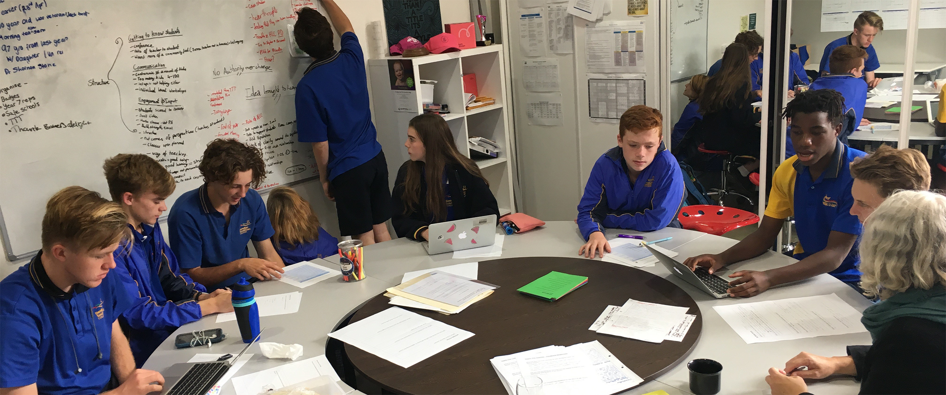
Students as Researchers
Webinar 3 of 4 in VicSRC’s Teach the Teacher series
Supported by the Victorian Department of Education and Training

Slide 2
Data from VicSRC’s Learning from Remote Learning report
Responses from students around how they felt about their learning during remote learning period:
The routine is not there, and it's hard to keep track of work when you're not at school
It's hard to keep up with the expected work, when it keeps accumulating.
I have less wasted time in class and am able to revise more at home
i could spend more time on things that i needed to work on and less time on the stuff that i was really confident with. it allowed me to spread my time easier between studying for subjects
Lack of motivation caused by isolated learning
I have more flexibility in when I decide to do my work. For example, I know that I don't work well early in the morning, so I'll enjoy my breakfast and talk to my family before starting work for the day.
General laziness and more lax punishment
I love working from home and I believe that I work well at home than at school since there is no one to disturb me at home and nothing else to worry about
I feel like remote learning has really set back my morale, motivation and mental health, and as such, although I am doing and understanding all the assigned work, I do not have the motivation or attention to do beyond the bare minimum of what is set.
Themes identified in the data:
Lack of motivation
Too much work
Decrease in mental health
More flexibility
More agency over learning
Harder to manage time effectively
Notes:
Theming data – congress pitches

Slide 3
Questions to guide students through sorting and analysing data

Slide 4
Why is changing this important to us?
What other students would it be important to?
Who does it impact?
Why is this urgent?

Slide 5
What can be done about the problem?
Who makes the decisions that could lead to change?
Will change involve a lot of money or time?
How can students be influencers?

Slide 6
Who do we need to get on board?
Who cares about this?
Who should care about this?
How do we get people to care about this?

Slide 7
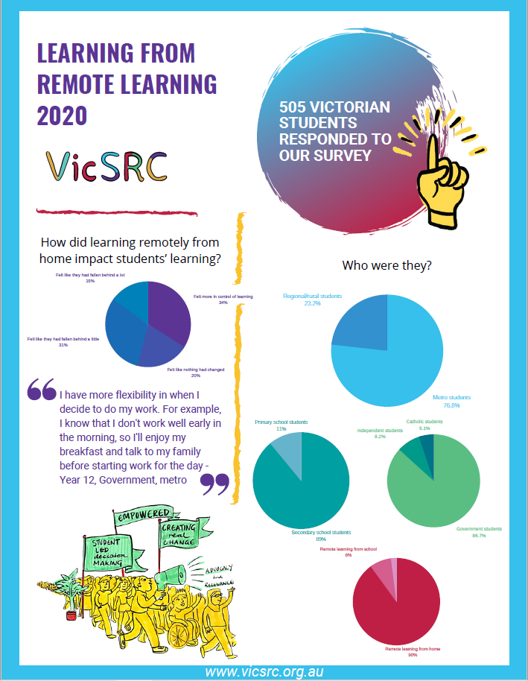
Make it professional and beautiful!

